Slide 1
© 2018 Cengage Learning®. May not be scanned, copied or duplicated, or posted to a publicly accessible website, in whole or in part.

Slide 2
Positioning
5
© 2018 Cengage Learning.® May not be scanned, copied or duplicated, or posted to a publicly accessible website, in whole or in part.

Slide 3
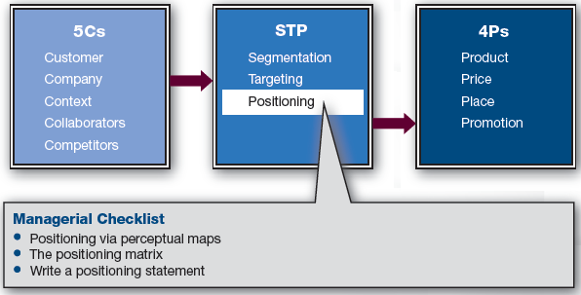
Marketing Framework

Slide 4
What Is Positioning?
Positioning
Who your brand or company is in the marketplace, vis-à-vis the competition, and in the eyes of the customer
It has physical and perceptual elements
STP = Segmentation, Targeting, and Positioning

Slide 5
Discussion Questions #1
Describe the positioning for the following:
Stanford
Your local community college
A local technical school
A state university
How does a firm obtain its position?

Slide 6
What Determines Positioning?
Positioning is determined by the marketing mix
Product
Price
Place
Promotion

Slide 7
Positioning via Perceptual Maps
Perceptual maps show graphical depictions of how the brands and their competitors are perceived in the minds of customers
Brands close together are seen as similar
Brands farther apart are viewed as different

Slide 8
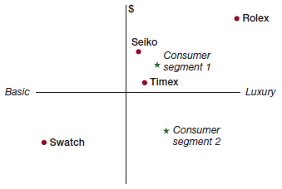
Positioning Questions #1
Which brands are most interchangeable?
Which brand competes more with Timex?
Which brand(s) is attractive to segment 1?
What market opportunity exists?
Is this opportunity a reasonable offering?

Slide 9
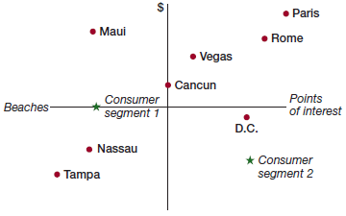
Positioning Questions #2
How would you compare Rome/Nassau?
The firm implemented a promotional campaign highlighting how reasonably priced Maui is. Was it successful?
Which segment offers an opportunity?

Slide 10
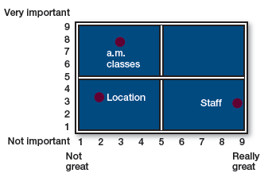
Positioning Questions #3
A yoga studio is rated on various qualities and their importance
Which quality is most important?
What is the studio doing well/not well?
What one thing would you invest in?

Slide 11
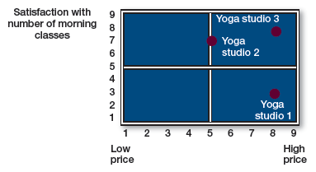
Maps for Competitive Analysis (slide 1 of 2)
Competitive yoga studios are rated
However, map is limited to two dimensions
Price and satisfaction with number of morning classes

Slide 12
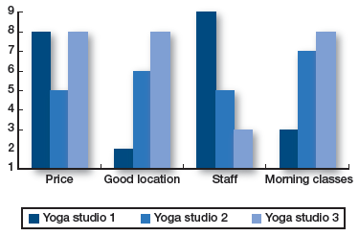
Maps for Competitive Analysis (slide 2 of 2)
Use a bar chart to show more than two dimensions

Slide 13
Discussion Questions #2
Use previous Figures 5.3 and 5.4 to answer the following questions
What do we (studio 1) do better than our competitors? Worse?
Combining Figures 5.3 and 5.4, what dimension should we consider improving first?

Slide 14
The Positioning Matrix
Companies usually can’t be great at everything due to limited resources
Can a firm realistically hold the lowest price, highest quality position?
Marketers need to determine the “best” position for the firm

Slide 15
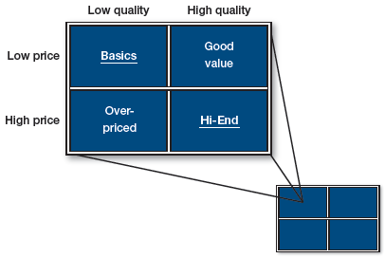
Product Quality by Price
Low-low and high-high make sense
Over-priced and good value products don’t make sense

Slide 16
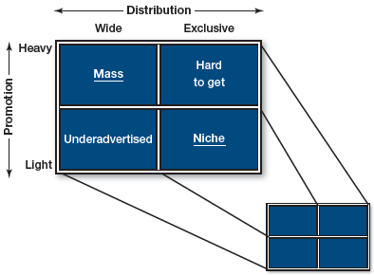
Promotion by Distribution
Heavy-wide and light-exclusive make sense
Underadvertised and hard to get products don’t make sense

Slide 17
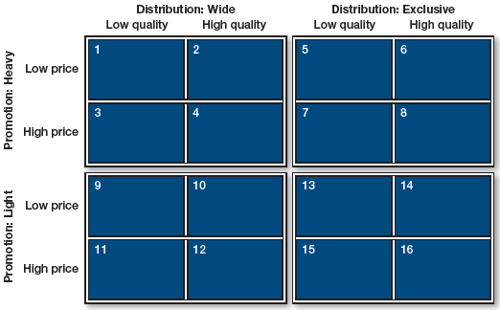
All 4 Ps Matrix
All 4P combinations are possible
However, some are more optimal than others

Slide 18
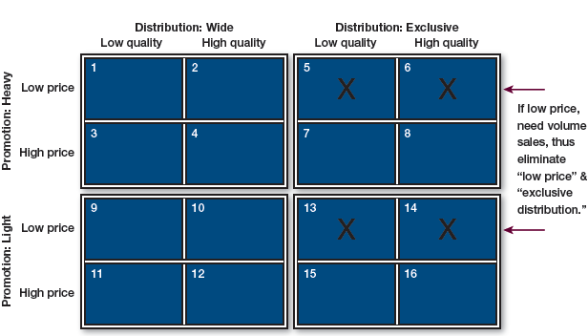
Suboptimal Matches (slide 1 of 3)

Slide 19
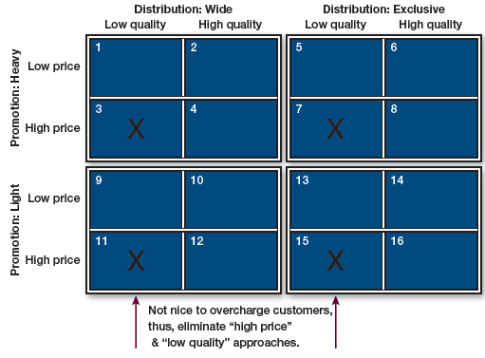
Suboptimal Matches (slide 2 of 3)

Slide 20
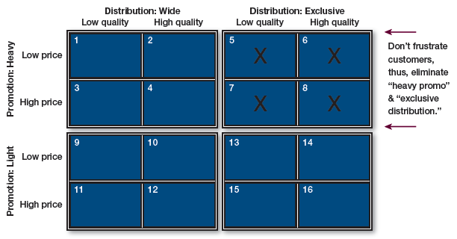
Suboptimal Matches (slide 3 of 3)

Slide 21
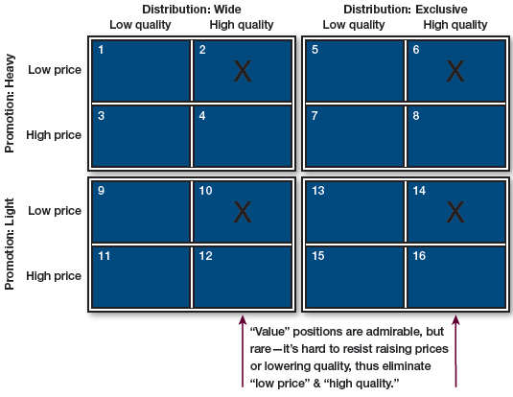
Hard-to-Sustain Matches (slide 1 of 2)

Slide 22
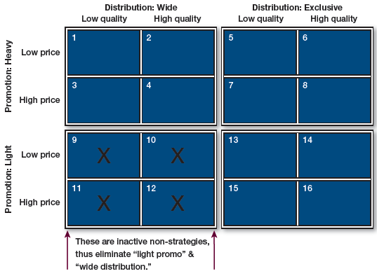
Hard-to-Sustain Matches (slide 2 of 2)

Slide 23
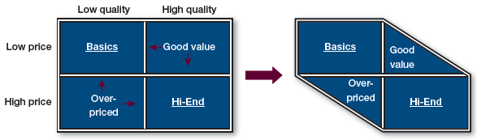
Quality and Price Align
Optimal matches:
High-end and value
Suboptimal matches:
Over-priced: customers stop buying; firms drop price, increase quality, or leave market
Good value: firms increase price or lower quality

Slide 24
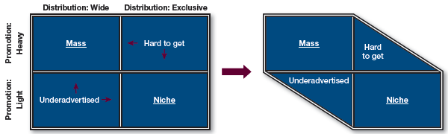
Promotion and Distribution Align
Optimal matches
Mass and niche
Suboptimal matches
Hard to get: Why promote heavily if consumers can’t find the product?
Underadvertised: If a brand has an exclusive image, why distribute it everywhere?

Slide 25
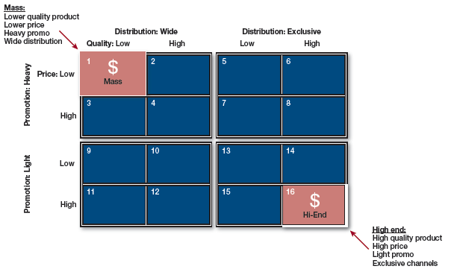
Optimal Matches
16 combinations can be reduced to two

Slide 26
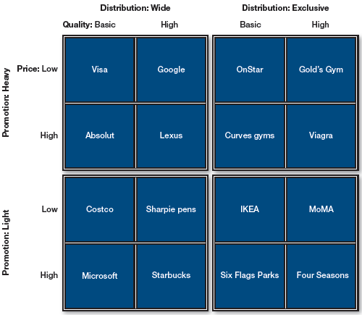
Examples of Brands in 4 Ps Matrix
In the real world, many brands occupy the natural matches; however, some brands appear in the suboptimal combinations
Have good reasons for moving from natural matches

Slide 27
Optimal Matches Aligned with Gurus
The two extremes in the matrix are consistent with management gurus
Treacy and Wiersema
Operational excellence (Southwest)
Product leadership (Apple)
Customer intimacy (Amazon)
Michael Porter
Keeping costs down and prices competitive
Leading by differentiation
Niche positioning

Slide 28
Writing a Positioning Statement (slide 1 of 3)
Positioning statement
Succinctly communicates parameters of a position
Consider
Your target market
Your unique selling proposition (USP)
If a “real” attribute difference does not exist, create a “perceived” image difference
e.g., For customers who want {target}, our brand is the best at {USP}

Slide 29
Writing a Positioning Statement (slide 2 of 3)
Answer the following questions:
Who are you trying to persuade?
Who are you competing with?
Who are your competitors? What is your major product category?
How are you better?
What makes you unique? What are your points of difference? Do you have any benefit that dominates competitors?

Slide 30
Writing a Positioning Statement (slide 3 of 3)
Make sure your statement is succinct
Prioritize your brand benefits and choose the most important, compelling differentiator
Think about what benefits the customer
Examples:
Walmart: “Save money. Live better.”
Porsche: “Engineered for magic. Every day.”

Slide 31
Discussion Question #3
Write a personal positioning statement to use when speaking to future employers.

Slide 32
Managerial Recap (slide 1 of 2)
Positioning is important
Positioning is seen through the eyes of the customer
Perceptual maps help facilitate an understanding of position
Positioning is achieved via the marketing mix

Slide 33
Managerial Recap (slide 2 of 2)
The positioning matrix demonstrates that certain marketing mix combinations are more optimal than others
Positioning statements guide marketing strategies and tactical actions
They should indicate the target, a competitive frame of reference, and a competitive advantage or unique selling proposition

